Slide 1
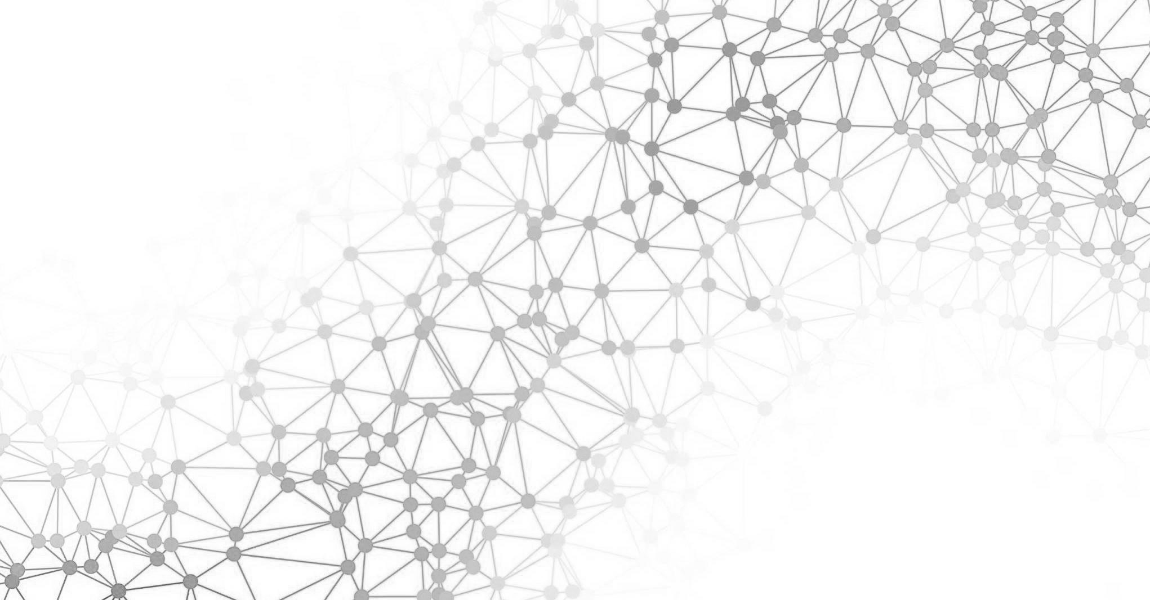

Introduction to Deep Learning
Jason Mancuso
Notes:
My name is Jason Mancuso
Today I’ll be talking about deep learning

Slide 2




Professional Background
B.S. in Mathematics where I developed
interest in machine learning and neural networks
Undergraduate research in machine learning for bio-informatics under Dr. Elena Manilich
Data scientist at Pandata, providing data science
solutions to organizations across Northeast Ohio
Mentor for the Artificial Intelligence Nanodegree
since February 2017
Notes:
studied Math at John Carroll
Had amazing opportunity to do Machine Learning research with the Cleveland Clinic
This is when I developed my fascination in Deep Learning
The clinic processes millions of blood samples per year
Thousands of these samples are contaminated which can skew results and potentially lead to incorrect medical care
B/C of the quantity of samples, it’s physically impossible to go through these by hand
We wanted to create an algorithm to identify contaminated samples but traditional machine learning techniques weren’t good enough
That is when I created my first deep neural network that was able to accurately identify contaminated samples, virtually solving the problem
Now I’m a data scientist at pandata where I’ve been able to create really cool models for a variety of different problems
I’m also a mentor for Udacity’s AI Nanodegree, helping students around the world learn AI

Slide 3
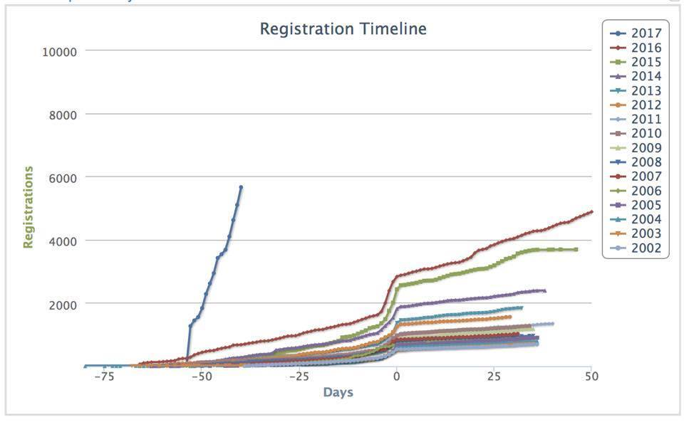
Conference on Neural Information
Processing Systems (NIPS)
Attendance
Registration
* AnswerOn
Notes:
So artificial intelligence has been blowing up in a big way since 2012.
NIPS (Neural Information Processing Systems) is the premier deep learning conference in the world
Attendance has more than doubled over the past couple years
This year, NIPS sold out during presale, emphasizing the growth we’ve seen in AI in general.
This growth is in large part due to advances in deep learning

Slide 4
Deep Learning
Using deep neural networks (or more precisely “distributed representations”) to perform machine learning
The fundamental innovation is around representation
What the machine learns from directly
Derived from raw data; it’s the data after it’s been transformed
Notes:
Deep learning is a set of methods using deep neural networks to perform machine learning
To reiterate, deep learning is a subset of machine learning
The key difference between classical ML and DL is in representation
At a high-level, representation is how a model detects patterns from the data it’s given

Slide 5




Machine Learning Workflow
Classical
Methods
Data
Processing
Feature
Engineering
Model
Training
Decision
Making
Notes:
With classical methods, representation is limited by human imagination
The representation is handcrafted through a process called feature engineering
For example, suppose we want to predict the price of a house, and we have data on square footage and the number of bedrooms. We might engineer a feature for average square feet per bedroom by dividing the square feet by the number of rooms, and include the result as a feature in our model.
In general, this is a time consuming process, and it turns out that it’s often a suboptimal way of going about predictive modeling.

Slide 6
Machine Learning Workflow
Classical Methods
Data
Processing
Feature
Engineering
Model
Training
Decision
Making
Deep Learning
Notes:
On the other hand, deep learning automates this feature engineering step by learning the representation while we train the model.
What we lose in interpretability, we gain back in performance.
DL typically works as well or better than competing models, depending on the problem

Slide 7
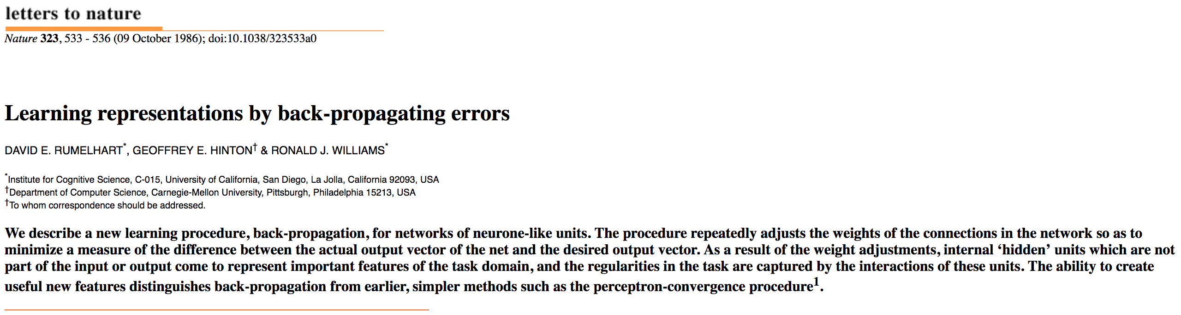
Notes:
Geoffrey Hinton, one of the founding fathers of DL, wrote a highly influential detailing this type of representation learning with neural networks
That’s beyond the scope of this talk, but we’ll go over how this works at a high-level

Slide 8
How it Works
Supervised learning on generic data
Given data X with labels y, find a function f such that y = f(X)
Notes:
Suppose we have a dataset with labels. For example, we have a set of labelled blood samples, which we know are either contaminated or normal.
Our goal is to predict whether a new blood sample we haven’t seen before is contaminated

Slide 9
How it Works
Supervised learning on generic data
Given data X with labels y, find a function f such that y = f(X)
cs231n – Andrej Karpathy
Notes:
We start by feeding data into the red layer of the network.
Data flows through the blue layers until it reaches the green layer, where a prediction is made
We measure how good the prediction was, and then adjust our network based on how well we did.
Repeating this process over and over allows the many blue hidden layers to learn a useful representation for prediction

Slide 10
ConvNetJS by Andrej Karpathy

Slide 11
Wait, this works? – Speech Recognition
Ming Hsieh, USC
Notes:
So I’ve continually claimed that this works, without actually offering any evidence. Here are some breakthroughs deep learning has achieved.
In automatic speech recognition, significant improvement hadn’t been made in ten years until deep learning was applied.
Deep learning is now used in Siri, Alexa, Google Assistant, etc.

Slide 12
Wait, this works? – Language Translation
Notes:
The same is true for translating languages. Incremental improvements were made until deep learning was applied to the problem
Now Google translate runs on DL

Slide 13
Wait, this works? – Image Recognition
ICML Tutorial -- Kaiming He, FAIR/Microsoft Research
Notes:
Neural networks have also provided a huge breakthrough in image recognition
Now computers can recognize images better than humans can on certain tasks

Slide 14
Wait, this works? – Reinforcement Learning
Youtube
Notes:
This is my personal favorite.
DL enabled Google to develop an AI that defeated the world’s best Go player Lee Sedol 4 out of 5 times.
It’s gotten better since then, and no longer loses at all
Experts thought this wouldn’t happen for another fifteen years

Slide 15
Why Deep Learning?
Recall supervised learning:
Given data X with labels y, find a function f such that y = f(X)
Universal Approximation Theorem: any continuous function can be (theoretically) approximated by a neural net with one hidden layer.
This does not guarantee we can find the right network with the data and optimization algorithm we have
In practice, deeper networks show better performance with a few tricks*
Intuitively, deeper layers facilitate higher-levels of abstraction, allowing for more complex representations
*batch/layer normalization or SELUs, ReLUs, advanced optimizers, dropout, skip connections, custom architectures like Inception module/stochastic depth, etc.
Notes:
So why deep learning?
Remember we wanted to find this function to predict labels
There is a mathematical justification up on the screen, but essentially deep learning detects complex patterns that humans can not easily detect

Slide 16
Dallin Akagi
Notes:
Here is an example of how a facial recognition network might work behind the scenes
The network is looking at raw pixel values in order to identify faces
First, it detects lower-level features like edges and curved lines
Next, it combines these into mid-level features. This includes parts of eyes, noses, ears, lips
Finally, it composes these into what we recognize as different human faces, which is the final representation it uses to make predictions
These hidden layers are not always so interpretable for humans, but the compositional process is always the same

Slide 17
Why Representation Learning?
Handcrafted features often require that the representation be human-interpretable
Computers use different representations than humans do, and we’re not good at guessing which representation will be useful
Learned representations can be reused for different tasks (transfer learning)
More theoretical justifications presented in Bengio et al.
Notes:
This process is in contrast to classical techniques, where handcrafting the representation requires that the features be somewhat human interpretable
Computers use different representations than humans do, and we’re not especially good at guessing which representation will be useful

Slide 18
How to Train a Neural Network
Two main steps
Choosing the architecture
Tuning the architecture
Each step can be considered “hyperparameter tuning”
This can be automated, but hand-tuning is often faster/finds a better solution
Notes:
Not many good resources online teaching how to build and train a neural network. Plenty of examples showing simple architectures, but hyperparameters are always dataset-specific, and it’s hard to find reliable resources on how to tune these. Stack overflow in particular is notorious for having
Can be automated with techniques like random search, Bayesian optimization, Hyperband, Harmonica
Only Harmonica has outperformed experts, but results may not have been statistically significant

Slide 19
Layer Structure
Block
Diavolo
Hamzehie et al.

Slide 20
Loss Functions
Regression
Classification
No output activation (usually)
Softmax or sigmoid output activation

Slide 21
Three Modern Architectures
The Standard
The Residual Network
The Self-Normalizing Network

Slide 22
The Standard
Activation functions: ReLU -- f(x) = max(0,x)
Batch normalization (batchnorm)
Normalize the inputs to each layer over the examples in each batch
Extra mean and standard deviation parameters that are learned over the course of training
Prevents internal covariate shift
Slight regularization effect (introduces slight bias in optimization, but slightly reduces variance)
Dropout
During training, randomly drop each neuron with probability p
At test time, multiply the weights by p
Prevents co-adaptation of neurons, a common cause of overfitting
Maximal regularization with p = 0.5
p = 0.2 is a good first choice with batchnorm

Slide 23
The Residual Network
Composed of many layers of residual blocks
Each block usually consists of two or three ReLU + BN + Dropout layers, with a skip connection from the input to the output
Skip connection allows gradients from later in the network to flow backwards more easily, unimpeded by intermediate networks
Avoids vanishing gradient problem that affects very deep networks
Tons of layers: common variants include 40, 60, 110, 152
StackExchange

Slide 24
The Self-Normalizing Network
Allows for creation of much deeper feedforward networks
What batch norm is supposed to do, but stable
Special activation function: SELU
Requires custom initialization (lecun_normal in Keras)
Also requires special version of dropout (Alpha Dropout)
Alpha Dropout: randomly set input to −λα
Limit of selu(x) as x goes to –inf
p = 0.05 or 0.1 are good defaults

Slide 25
Demo-ish
Notes:
Goal: loss will drop somewhat quickly for first couple epochs, converge towards a minimum during later epochs
Way too high: loss will fluctuate wildly, probably increase over time
Too high, loss will bounce around a bit, but remain relatively unchanged over time
Too low, loss will steadily decrease but won’t converge.

Slide 26
Tuning the Network
Size of the layers (capacity): Start with slightly more parameters than you have training samples
Start without any regularization (no batchnorm, no dropout)
Tune learning rate (next slide)
Increase size of network until you notice overfitting
Add batchnorm, then increase capacity a bit more until you overfit again
Add dropout (more effective than L1/L2 or elastic net due to efficiency and convergence considerations)
If tuned well, training error should be better than validation error, but still comparable
Not enough regularization, you’ll overfit
Too few parameters or too much regularization, you’ll underfit

Slide 27
Tuning the Learning Rate
By far, the most important hyperparameter to tune
Start with 0.001, then double or halve as many times as needed
Use Adam, RMSProp, or SGD with momentum (Nesterov momentum usually works even better)
Notes:
Goal: loss will drop somewhat quickly for first couple epochs, converge towards a minimum during later epochs
Way too high: loss will fluctuate wildly, probably increase over time
Too high, loss will bounce around a bit, but remain relatively unchanged over time
Too low, loss will steadily decrease but won’t converge.
More efficient to do this on a subset of the data

Slide 28
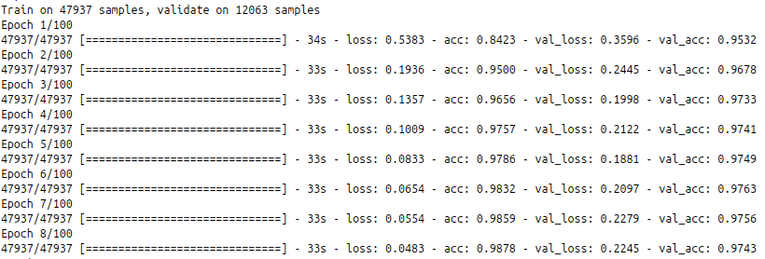

Slide 29
Thank you!
Questions?
@jvmancuso
jason@pandata.co
github.com/jvmancuso

Slide 30
Disadvantages of Deep Learning
Hard to train! Model architecture and tuning depends on dataset (dark art)
Current research directions on evolving network architecture and tuning with hyperparameter optimization/reinforcement learning (all part of the AutoML research trend)
Long to train! Requires GPU to train efficiently and development can be complex
Open-source libraries* abstract away implementation details and interface with GPUs (even in the cloud!)
Distributed training algorithms exist and are an open area of research
Trade interpretability for performance
Inner workings of the model are not interpretable to humans
* PyTorch, Keras/Tensorflow, Theano, Caffe, etc.

Slide 31
Broader Limitations
Sample efficiency! Easy tasks require very little data, but complex tasks require much more
There is data everywhere; open research directions into one-/few-shot learning
Optimization! Often we cannot find the best network with current methods, but one that works “well enough”
More sophisticated optimization routines, especially “learning to learn” research direction
Intelligence! Can deep learning really lead to superintelligence, or is this just pattern recognition?
It’ll probably be useful in the final solution, but we’ll need a paradigm shift before that happens.
See Karpathy’s recent talk for more.

